Slide 1


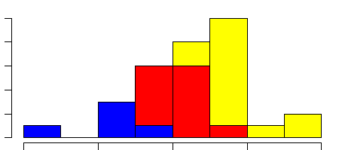
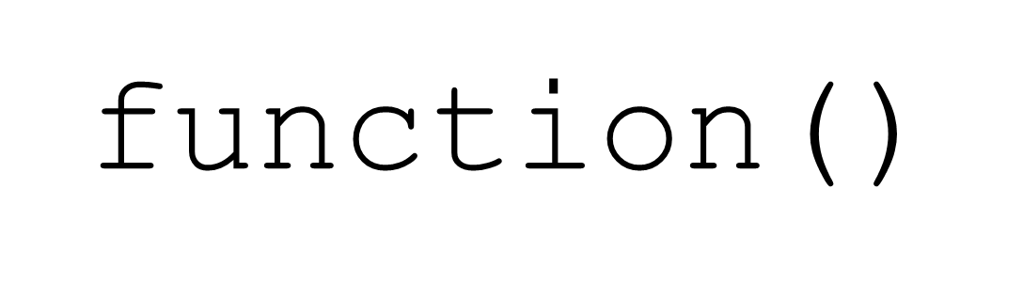
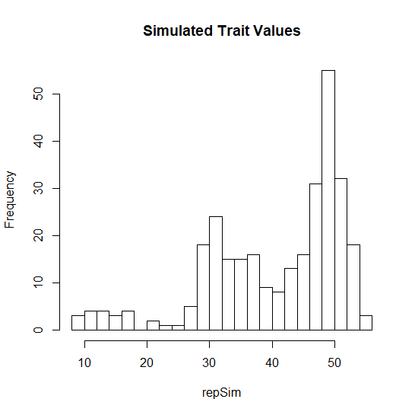
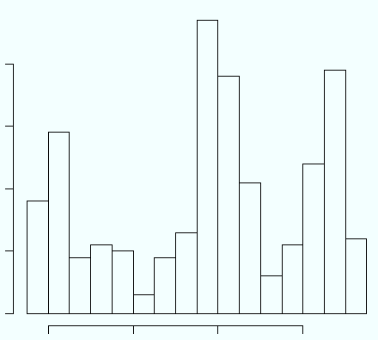
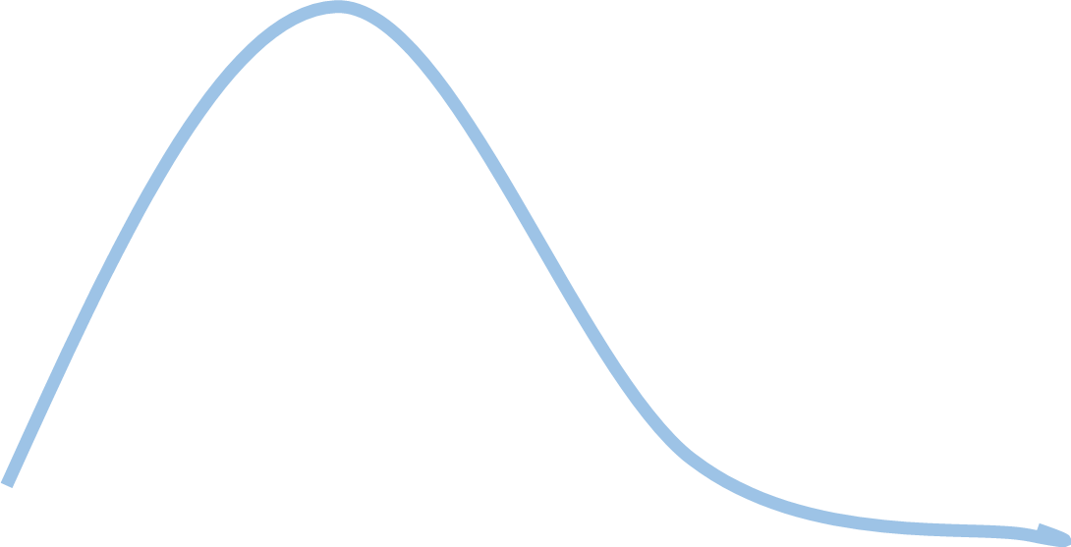
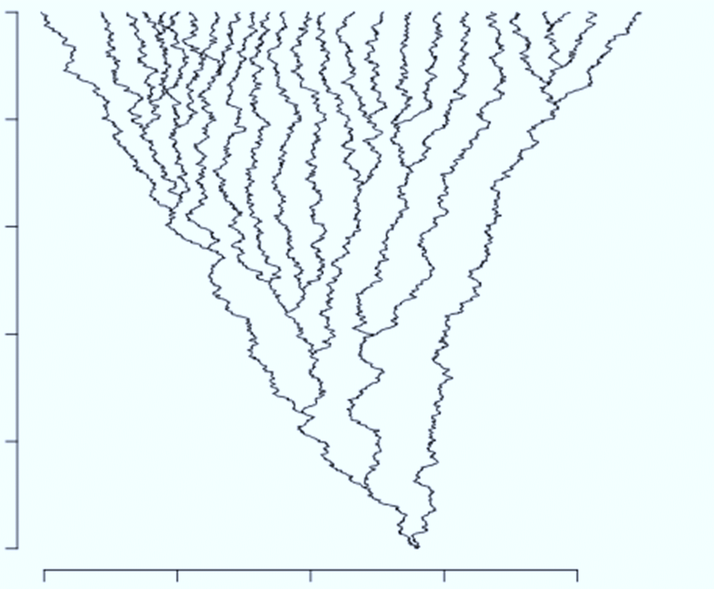
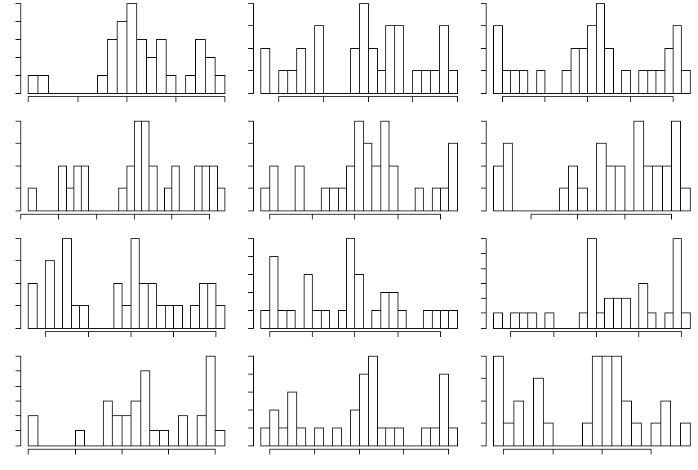
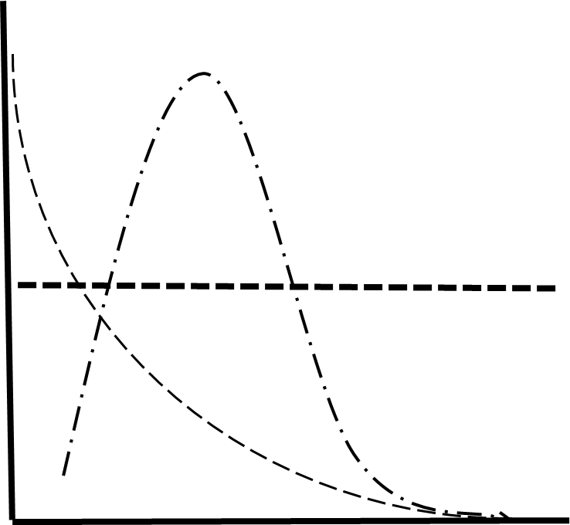

If You Can Simulate It, You Can Fit It
Do-It-Yourself Phylogenetic Models of Trait Evolution for the Fossil Record with the R Package TreEvo
David Bapst, Brian O’Meara & Barb Banbury
The Problem
Modeling Trait Evolution with TreEvo
Pollinator Regimes with different optima, unidirectional bounds…
X_{t} ~ X_{t-1} + Intrinsic Δ + Extrinsic Δ
Aquilegia: Floral Spur Length
Arbitrary Optima
Parameter Estimates?
Example
Example
Whittall and Hodges, 2007
Character Displacement
Bound
Bound
Model Likelihood = ???
Time
Trait
Aquilegia: Floral Spur Length
Trait
The Solution: Approximate Bayesian Computation (ABC)
Limits of ABC
Slow
Identifiability
Trait evolution models should be match our biological understanding, not methodological limits. What new models can you imagine?
Draw New Parameter Values
Parameter Estimates
Simulate Trait Change On Input Tree
Posterior
Priors
Prior
Ancestral State
Posterior
Compare For Acceptance to Posterior
Prior
Summary Statistics λ, α, β, δ, ρ, μ, ¥, §… etc (Reduced with PLSR)
For the package, see: https://github.com/bomeara/treevo
Rate of Change

